Slide 1
AI-Powered Chatbot for FDA Drug Labeling Information Retrieval: OpenAI's GPT for Grounded Question Answering
Manasa Koppula (mk47542)
manasakoppula@utexas.edu
Master of Science in Artificial Engineering
University of Texas at Austin
Austin, Texas, USA
Fnu Madhulika (fm22739)
madhulika27@utexas.edu
Master of Science in Artificial Engineering
University of Texas at Austin
Austin, Texas, USA
Navya Sreeramoju (ns38687)
navyasreeramoju@utexas.edu
Master of Science in Artificial Engineering
University of Texas at Austin
Austin, Texas, USA
Git link:

Slide 2
Background
Every FDA-approved drug has a legally binding label that guides safe and compliant usage, structured into standard sections like “Indications and Usage”, “Dosage and Administration”, “Warnings and Precautions”, “Adverse Reactions”, “Drug Interactions”, “Use in Specific Populations”, “Patient Counseling Information”, and “Reporting and Manufacturer Information”.
These labels are highly technical, dense, and span multiple pages, making manual information retrieval difficult.
Tools like BioBERT, PubMedBERT, and search engines exist but may generate unreliable answers due to hallucinations from general data.
In regulatory domains, AI responses must be grounded to official documents to ensure factual accuracy and legal compliance.
This work aims to develop a ChatGPT-powered QA system that queries FDA labels directly and provides document-grounded, verified answers.

Slide 3
Advantage and Use-case
Advantages of drug summarization:
Accurate Information Retrieval: Extracts specific data from FDA drug labeling PDFs.
Section-Specific Focus: Targets key medical sections like Indications, Dosage, Warnings, etc., improving relevance.
Authentic and Relevant Answer: Provides answers that are trustworthy and directly tied to approved documents.
Document-Grounded QA: Ensures all responses are strictly based on the original drug label, avoiding hallucinations.
User Assistance :Helps users (e.g., clinicians, Doctor, pharmacists) get fast, reliable answers without reading long documents.
Use Cases:
In healthcare – for Doctor, clinicians and Pharmacists to quickly refer to FDDA approved drug.
Understand drug side effect efficacy , doses , side effect and other details.
Useful for patient to get information in simple text without going though many pages of documentations.

Slide 4
Data Used, Objective of the Project and Approaches
Data used: We focused on 30 Oncology FDA-approved drugs Label.
https://www.cancer.gov/about-cancer/treatment/types/targeted-therapies/approved-drug-list
Objective:
Create a Chatbot, which can be take input of FDA Drug label document and generate responses to the user queries without hallucinations.
To evaluate the performance of responses generated by Chatbot using Sematic Similarity Score.
Approach used to evaluate perfromance:
The Sentence Transformers model, based on pre-trained transformer model MiniLM-L6-v2, is employed.
Vectorization is used to convert both the Chabot's generated answers and the "Ground truth" text (from the FDA label) into dense vector embeddings.
Next cosine similarity is calculated between the Chabot's embeddings and the Ground truth embeddings to understand Semantic Similarity.

Slide 5
Data Processing
upload PDF
Raw data
uploads a PDF of a labeling document of FDA approved drug.
PyMuPDF to parse the PDF into plain text.
slices the document into structured segments for headings.
Focus on context-specific answers. The five sections mentioned below are the focus of this study.
Indications and Usage
Dosage and Administration
Warnings and Precautions
Adverse Reactions
Drug Interactions
parse PDF using PyMuPDF
plain text from PDF
Slice the document into segment
Context Specific answer

Slide 6
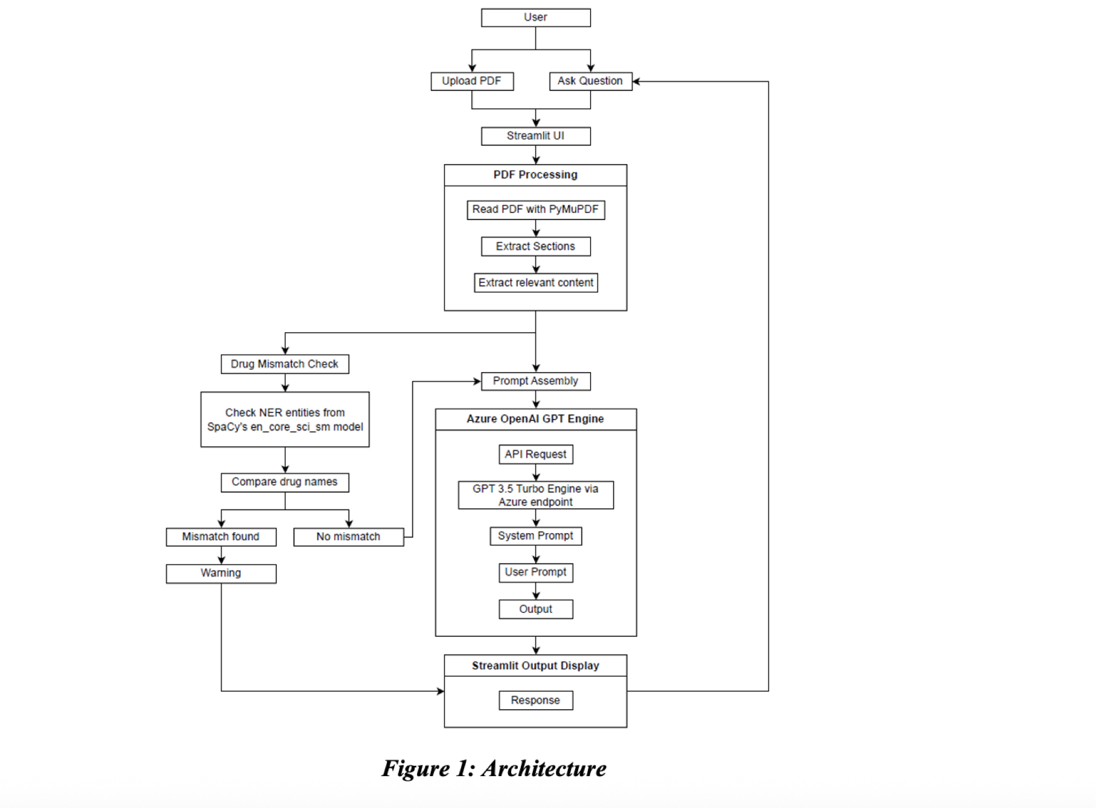
Chatbot Solution
The system utilizes Streamlit, a lightweight, interactive web framework that simplifies the process of creating interactive applications.
Users can:
Upload the FDA labeling document of a drug in PDF format.
Ask natural language questions about the drug.
Receive answers generated by the AI model that are limited strictly to the uploaded document’s content.

Slide 7
Demo

Slide 8
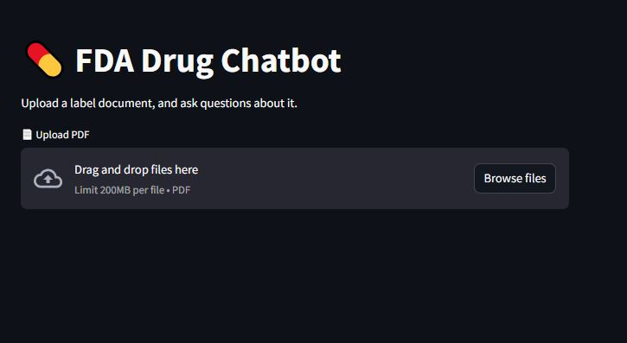
Screenshots of Interface

Slide 9
Results
Sections having shorter paragraphs where there isn’t much scope to summarize, or sections that are one-liners, have higher scores (0.8 – 0.9).
Ground truth | Generated answer | Semantic score
PIQRAY is a kinase inhibitor indicated in combination with fulvestrant for the treatment of adults with hormone receptor (HR)-positive, human epidermal growth factor receptor 2 (HER2)-negative, PIK3CA-mutated, advanced or metastatic breast cancer as detected by an FDA-approved test following progression on or after an endocrine-based regimen. (1) | PIQRAY is a kinase inhibitor indicated in combination with fulvestrant for the treatment of adults with hormone receptor (HR)-positive, human epidermal growth factor receptor 2 (HER2)-negative, PIK3CA-mutated, advanced or metastatic breast cancer as detected by an FDA-approved test following progression on or after an endocrine-based regimen. | 0.99
Tamoxifen: Do not use in combination with ARIMIDEX. No additional benefit seen over tamoxifen monotherapy. (7.1, 14.1) â€¢ Estrogen-containing products: Combination use may diminish activity of ARIMIDEX. (7.2) | Tamoxifen should not be used in combination with ARIMIDEX as no additional benefit is seen over tamoxifen monotherapy. Additionally, combination use of ARIMIDEX with estrogen-containing products may diminish the activity of ARIMIDEX | 0.97

Slide 10
Results
Moderate scores (0.6 – 0.75) can occur when the answer summarizes multiple lines or rephrases legal language into simpler sentences, reflecting desirable paraphrasing without loss of meaning. For example, the DATROWAY drug, as shown in Table 2, has length passage, yet the model simplified it effectively without losing meaning and gave appropriate information.
Ground truth | Generated answer | Semantic score
Interstitial Lung Disease (ILD) and Pneumonitis: DATROWAY can cause severe and fatal cases of ILD/pneumonitis. Monitor for new or worsening signs and symptoms of ILD/pneumonitis. If ILD/pneumonitis is suspected, withhold DATROWAY and initiate corticosteroids. Permanently discontinue DATROWAY in patients with confirmed Grade 2 or higher ILD/pneumonitis. (5.1)? Ocular Adverse Reactions: DATROWAY can cause ocular adverse reactions including dry eye, keratitis, blepharitis and meibomian gland dysfunction, increased lacrimation, conjunctivitis, and blurred vision. Monitor patients for ocular adverse reactions during treatment with DATROWAY. Advise patients to use preservative-free lubricating eye drops and to avoid using contact lenses during treatment with DATROWAY. Dose delay, dose reduce, or permanently discontinue DATROWAY based on the severity of ocular adverse reactions. Refer patients to an eye care professional for any new or worsening ocular signs and symptoms. (2.2, 2.3, 5.2)? Stomatitis/Oral Mucositis: DATROWAY can cause stomatitis, including mouth ulcers and oral mucositis. Advise patients to use a steroid-containing mouthwash when starting treatment and to hold ice chips or ice water in mouth during the infusion of DATROWAY. Based on the severity of the adverse reaction, withhold, dose reduce, or permanently discontinue DATROWAY. (2.2, 2.3, 5.3)? Embryo-Fetal Toxicity: DATROWAY can cause fetal harm. Advise patients of potential risk to a fetus and to use effective contraception. (5.4, 8.1, 8.3) | The warnings for DATROWAY include Interstitial Lung Disease (ILD) and Pneumonitis, Ocular Adverse Reactions, Stomatitis/Oral Mucositis, and Embryo-Fetal Toxicity. | 0.67

Slide 11
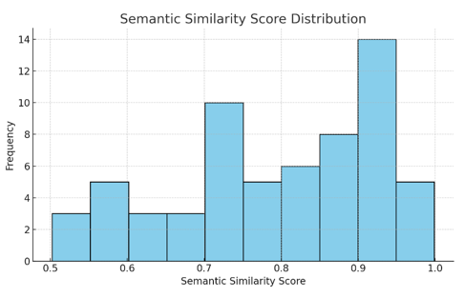
Semantic Similarity Score Vs Frequency
High scores (0.8 – 0.9): Sections having shorter paragraphs where there isn’t much scope to summarize, or sections that are one-liners have higher scores
Moderate scores (0.6 – 0.75): Occur when the answer summarizes multiple lines or rephrases legal language into simpler sentences, reflecting desirable paraphrasing without loss of meaning.
Most of the answers have similarity scores moderate or higher.

Slide 12
Future Improvements and Conclusion
Potential future improvements:
Solution can be extended with Automatic flagging of low-similarity responses for human review in critical cases
GPT or another LLM specifically on FDA labeling language to further reduce hallucinations and improve precision.
Implement follow-up question handling so the chatbot can ask clarifying questions if the query is vague.
Link the system with FDA’s official database to automatically fetch latest drug label.
Add translations or simplified summaries for patients who may not understand medical jargon or English well
Conclusion:
This project demonstrates a practical, document-grounded question-answering (QA) system for navigating complex FDA drug labeling documents. The system addresses key gaps found in general–purpose LLM’s namely the risk of hallucination and the lack of traceability. This approach demonstrates that LLMs can be deployed responsibly in sensitive, high-stakes domains, such as medical regulation.

Slide 13
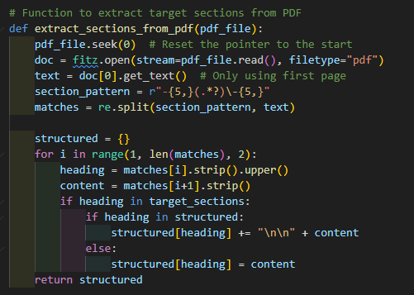
Data Processing

Slide 14
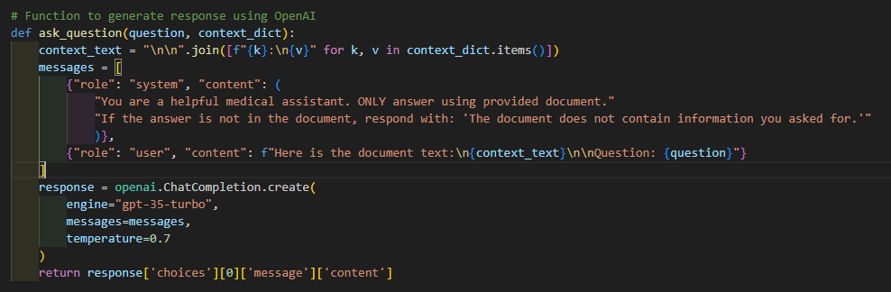
Chatbot Solution

Slide 15
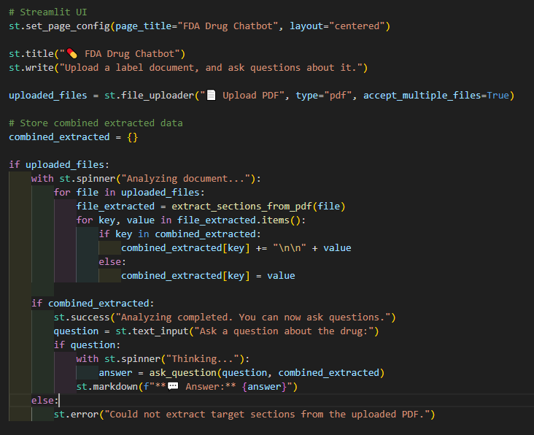
Chatbot Solution

Slide 16
Thank you

